Slide 1


Salesforce Colorado Technology Day
Developer 401 Lite Training
Michael Yeganeh
Senior Director, Solution Engineering
June 29, 2017

Slide 2
Safe Harbor
“Safe harbor” statement under the Private Securities Litigation Reform Act of 1995:
This presentation contains forward-looking statements, the achievement or success of which involves risks, uncertainties, and assumptions. If any such risks or uncertainties materialize or if any of the assumptions proves incorrect, the results of salesforce.com, inc. could differ materially from the results expressed or implied by the forward-looking statements we make.
The risks and uncertainties referred to above include – but are not limited to – risks associated with possible fluctuations in our financial and operating results; our rate of growth and anticipated revenue run rate, including our ability to convert deferred revenue and unbilled deferred revenue into revenue and, as appropriate, cash flow, and our ability to grow deferred revenue and unbilled deferred revenue; errors, interruptions or delays in our service or Web hosting; breaches of our security measures; the financial impact of any previous and future acquisitions; the nature of our business model; our ability to continue to release, and gain customer acceptance of, new and improved versions of our service; successful customer deployment and utilization of our existing and future services; changes in our sales cycle; competition; various financial aspects of our subscription model; unexpected increases in attrition or decreases in new business; our ability to realize benefits from strategic partnerships; reliance on third-party computer hardware and software; the emerging markets in which we operate; unique aspects of entering or expanding in international markets; our ability to hire, retain and motivate employees and manage our growth; changes in our customer base; technological developments; regulatory developments; litigation related to intellectual property and other matters, and any related claims, negotiations and settlements; unanticipated changes in our effective tax rate; factors affecting our outstanding convertible notes and credit facility; fluctuations in the number of shares we have outstanding and the price of such shares; foreign currency exchange rates; collection of receivables; interest rates; factors affecting our deferred tax assets and ability to value and utilize them, including the timing of achieving profitability on a pre-tax basis; the potential negative impact of indirect tax exposure; the risks and expenses associated with our real estate and office facilities space; and general developments in the economy, financial markets, and credit markets.
Further information on these and other factors that could affect the financial results of salesforce.com, inc. is included in the reports on Forms 10-K, 10-Q and 8-K and in other filings we make with the Securities and Exchange Commission from time to time, including our most recent Form 10-K. These documents are available on the SEC Filings section of the Investor Information section of our website at www.salesforce.com/investor. Any unreleased services or features referenced in this or other presentations, press releases or public statements are not currently available and may not be delivered on time or at all. Customers who purchase our services should make their purchase decisions based upon features that are currently available.
Notes:
Key Takeaway:
It has been our mission from the very beginning to move our enterprise customers to the cloud. We were born cloud and always have been. We are customer focused and passionate about cloud computing for the following reasons.
There is no hardware or software to buy, manage or maintain
A subscription model allows our customers to buy as need grows.
Automatic upgrades mean that our customer can stay focused on the business
Constant innovation allows us to deliver a future proof solution to our customers
Talk Track:
For fourteen years, salesforce.com has been a driver for enterprise cloud computing.
With cloud computing, we are helping the world shift from mainframe and client-server to cloud computing.
Cloud computing is a delivery model that allows companies to access any application over the Internet. Unlike client server and mainframe, you don’t have to buy or manage hardware, software or infrastructure. With a subscription model, you pay fixed predictable monthly payments with no large, upfront capital expenditures. And with automatic upgrades, we automatically upgrade you three times a year. These means that you are always getting the latest innovation so you can focus on your business, not technology. Today, cloud computing provides customers the fastest path to success.

Slide 3

Agenda
Customize the User Interface:
Views, Page Layouts, Social
Welcome & Introductions
Declarative Application Logic: Formulas, Validation, Workflow
Salesforce Platform Overview &
Core Services
Building Reports and Dashboards
Declarative Application Development: Create an Application & Database
Mobile

Slide 4

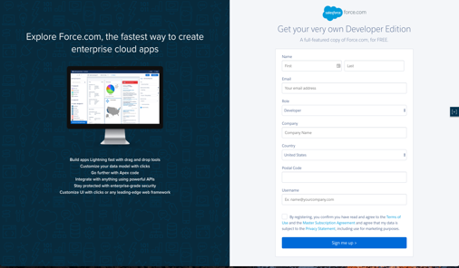


developer.salesforce.com/signup
User Name must be in the form of an email address
e.g. first.last@developer.org
Best to **NOT** use your real work email address for your User Name
Org Sign-up

Slide 5

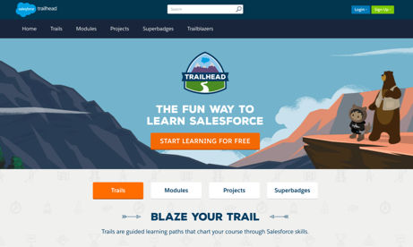
trailhead.salesforce.com

Slide 6

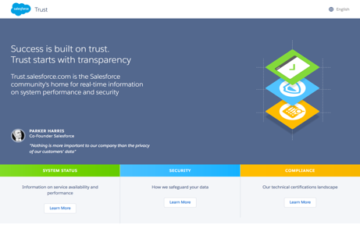
trust.salesforce.com
Live & up to date system performance data
Up-to-the minute information on planned maintenance
Phishing, malicious software and social engineering threats
Security best practices for your organization
Information on how we safeguard your data
Notes:
Talk to Transparency of Trust.Salesforce.com
Even demo the site

Slide 7


Development Lifecycle Guide
Enterprise Development Best Practices
https://resources.docs.salesforce.com/sfdc/pdf/salesforce_development_lifecycle.pdf
This guide prepares you to undertake the development and release of applications on the Force.com platform.
It starts with the most basic scenario, using a developer sandbox and change sets.
Later chapters address other development environments, tools, and processes for more complex enterprise scenarios.
Notes:
MRU - maybe hide this for IEDW?

Slide 8

Notes:
MRU – do we still call it this?

Slide 9






The Customer Success Platform
SaaS
CRM
Service
Marketing
Community
Analytics
Apps
Open Ecosystem
2,700+ Partner Apps
PaaS
Scalable Metadata Platform
APIs
Custom Objects
Mobile UI
Collaboration
Analytics
Workflow
Identity
Fast App Dev & Customization
Trusted Multitenant Cloud
Notes:
BTMURPHY Note to Presenter: This Slide Builds and the impactis in how you explain the story…and click the animations to explain the story…. NOTE you can change the text of the example apps if needed.
======
So let’s discuss a little about WHAT exactly DOES and explain a little about what we mean by the “Government Success Platform”
CLICK FOR FIRST ANIMATION
First and foremost, Salesforce is an enterprise cloud applications company. We deliver several pre-built applications (called “clouds”) for managing COMPLETE CRM (citizen relationship management) business processes. These applications cover the ability to manage relationships and interactions between citizens, families, households, constituents, providers, stakeholders etc. These applications are offered in a SaaS model. Typically, You pay us per user/per month for access to these applications.
CLICK FOR NEXT ANIMATION
Now all of these applications are built on our SECURE & TRUSTED MultiTenant Cloud Platform so you never have to worry about infrastructure, servers, networks or sizing. You can start with 1 user today and tell us tomorrow that you want 50,000 users and it’s no problem. That’s the whole point behind the instant elasticity and scalability of our service. We call this our Salesforce Platform/App Cloud and it’s been recognized by Gartner as the #1 APPLICATION PLATOFRM AS A SERVICE (aPaaS). With the platform you get a core set of business services that allow you to extend and configure the applications at the SaaS level. These are just a sampling of the core services… things like Workflow, Reporting & Dashboards, Mobile, Identity Management and Integration via common API’s like SOAP-based and REST-based web services to connecting to external or 3rd party applications.
CLICK FOR ANIMATION
Now we allow you our customers to use the Platform to build your own CUSTOM APPLICATIONS so you can build applications QUICKLY in the cloud because you are building apps in a declarative fashion with clicks/not code…
CLICK FOR ANIMATION
So each of these clouds can help government agencies in a variety of ways… talk to some of the examples like 311, Econ Dev, IT Help Desk, Communities etc…
CLICK FOR NEXT SLIDE… then cover all the examples of apps that Governments have built on the platform… then go to customer stories after that

Slide 10
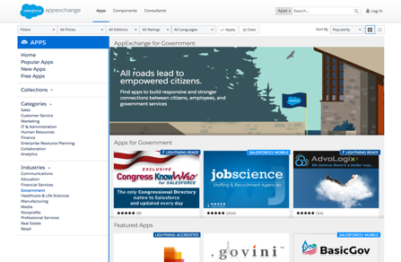
AppExchange
Word’s Largest Business App Marketplace
Approximately 3000 apps across all industries and business lines
Over 4M app downloads
2.4M+ developers
Government-specific AppExchange
Notes:
MRU – I updated # apps to be 3000 and the app downloads line to 4M. Note sure how many apps or developers there are now.
Welcome to the world's largest business app marketplace
Building apps is only one part of the salesforce one platform. You can
also get ready made apps on the salesforce app exchange with free apps
to get you started or full-blown enterprise grade apps as well as
customer reviews you can easily find solutions for any department or
industry
And apps built 100% natively on the salesforce one platform share an
integrated secure data and identity management model so you don't have
to worry about integration and security hassles.
Plus, apps on the app exchange are all connected to the salesforce one
platform, so users only need one login to manage. And each app goes
through a rigorous security review, so you know your companies
information is secure and trusted inside of salesforce.
And the best part is that apps are easily to customize so you can get
the app you want and leverage lightning developer tools to make it
work even better for your business and if you build an app on the
salesforce one platform you can list it and sell it too
========= Gov’t ======
New AppExchange for Government: The App Marketplace for the Public Sector
The new AppExchange for Government provides a central cloud app marketplace where government agencies can drive their social transformations and reduce costs by quickly identifying applications to meet their needs. AppExchange for Government is a one-stop shop for everything from help desks and asset management, to program and project management, to constituent relations and more. Launching with more than 60 apps selected specifically for government and public sector agencies, AppExchange for Government includes apps like:
BasicGov: BasicGov is a reliable, secure application built on Force.com that allows cities, counties, state governments and government agencies to streamline permitting and inspections, code enforcement, planning, licensing and citizen access.
DocuSign: DocuSign is a leading eSignature application built on Force.com that helps organizations streamline workflows to accelerate transactions, reduce costs, and delight constituents with the fastest way to send, sign, track, and store documents in the cloud.
SchoolForce: SchoolForce includes essential Student Information System (SIS) modules such as attendance, behavior, homework, student records and grade book, as well as collaboration and document management – all of which can all be shared with parents and students via a Web portal. SchoolForce powers data driven improvements in student outcomes and represents a significant advancement in the measurement of K-12 student, teacher and school performance by tapping the power of cloud technologies and advanced analytics.
AppExchange for Government builds on the tremendous success of salesforce.com's AppExchange which currently has more than 1,400 cloud apps that have been test driven or deployed more than one million times by salesforce.com's more than 100,000 customers.

Slide 11




The Travel Approval App
January 26, 2014
Notes:
Hi Everyone, my name is ___________ and I’m a ___________ at Salesforce. Today, I’d like to take you through the process of building a custom application in Salesforce from scratch. And we’re going to show you how to do that with the Salesforce Customer Success Platform.

Slide 12

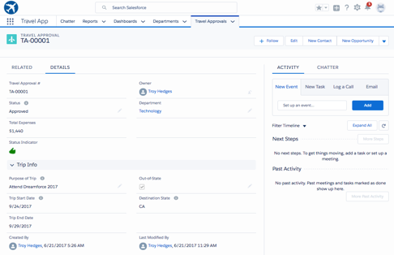
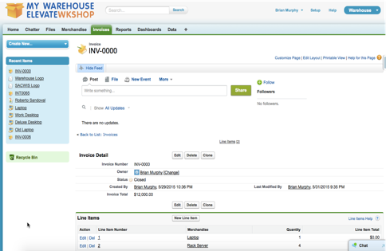
The Travel Approval App
At the heart of this app are Travel Approval requests
Employees requesting approval before taking a trip that will have expenses
Create Travel Approval request containing one or more expenses as an expense items
Relate Department to Travel Approval
Start by creating a custom app, objects and fields
Notes:
MRU – For IEDW, say that when building this app, we assumed one agency (FSSS) with multiple departments. In reality, you could roll something like this out to all agencies (or multiple)…all you would need to do is add an Agency object and relate it to the Departments object that you will see in this application. You would also use a hierarchy of Roles and Ownership of data to segregate the data between Agencies (i.e. the role at the top of the hierarchy – CEO - would be able to see all Travel approvals across multiple agencies…maybe the Governor would like to see this ;-)…and the roles at the very bottom of the hierarchy would only be able to see their own data (plus any data that was specifically shared with you through manual or automatic methods.)

Slide 13
Travel Approval Data Model Schema
Department
Name | Code
Division of Family Services | 405-13
Travel Approval
Approval # | Purpose | Total Expenses | Status | Start Date | Owner
TA-001 | Dreamforce 17 | $1395 | Submitted | 2/12/2017 | Tom Smith
TA-002 | IT Conference | $1423 | Pending Approval | 1/5/2017 | Sally Roosa
TA-003 | Training | $1290 | Rejected | 1/15/2017 | Rob Wagner
TA-004 | Executive QBR | $4735 | Approved | 3/7/2017 | Amy Pitta
 | Expense Item
Item # | Type
1 | Hotel | $760
2 | Airfare | $370
3 | Rental Car | $115
4 | Other | $150
Notes:
MRU - graphics need changed to be the Travel Approval app data model schema. Come back to this after build. Hiding for now because slide 34 should suffice for the IEDW.

Slide 14

Create an Application and Database
Notes:
MRU – for IDEW, explain that we have already built out most of the database to save time (and boredom.)

Slide 15
Overview: Create an Application & Database
Create an application
How to design your Salesforce Data Model
Create custom objects and fields
Relate objects
Data import tools

Slide 16

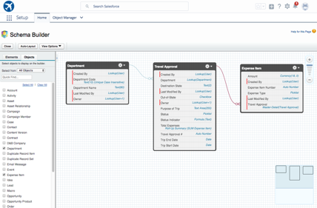
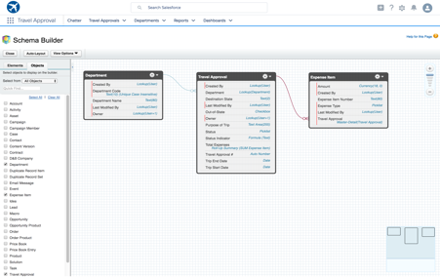

Open Cloud Database
Database Services
Structured relational data storage
Unstructured file-oriented content
Database-level caching for improved performance
Triggers and validation rules
Automatic indexing, backup, replication, and disaster recovery
Full text search and SOQL for querying relational data
Auto-scaling to support any size application
Cloud Database
Notes:
What would you rather have your IT department doing?
Building, securing, managing, and virtualizing a new database for each new application project you are executing?
Or innovating immediately on the apps that the business needs today?
The Salesforce1 Platform puts the world’s #1 cloud database technology at IT’s fingertips to build rich forms and customer data models without complex code.
So resources can be devoted to creating apps that create business value, faster.
It’s traditionally been a tremendous challenge for IT to create an architectural environment that effectively brings together data from your apps. Infrastructure as a Service (IaaS) and other Platform as a Service (PaaS) offerings simply haven’t done much to make this easier.
But with the Salesforce1 Platform, all the apps supporting your business processes interact with exactly one (and only one) version of the data that is consistent and transactional. That means everyone is seeing the same view of the data—and IT doesn’t have to spend money on expensive integration between apps.

Slide 17
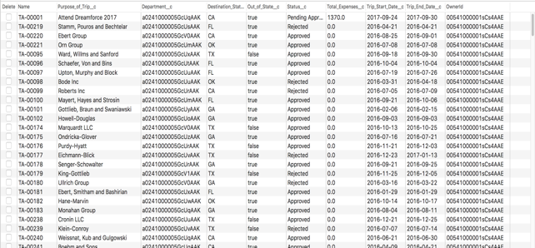
What is a Salesforce Object?
A logical business entity you track in your business
Think of a Salesforce Object as a Data Table
Records are rows
Columns are Fields
Examples
Accounts
Contacts
Cases
Contracts
Policies
Service Plans
Benefits
Incidents
Travel Approval

Slide 18
Field Data Types
Salesforce offers multiple field data types
Numeric
Limited Option
Text
Calendar
Formatted Text
Calculation
Number
Currency
Percent
Checkbox
PickList
PickList Multi-Select
Text
Text Area
Text (Long)
Text (Rich)
Encrypted
Date
Date & Time
Email
Phone
URL
Auto-Number
Formula
Roll-up Summary
Geolocation

Slide 19
Relating Objects
Department
1:M, M:M, M:1
Parents-to-Children
1-to-Many
Relationship is defined at the child level by a field type
Master-Detail Relationship
Lookup Relationship
Many-to-Many
Via Junction Object
Travel
Approvals
Expense Items

Slide 20
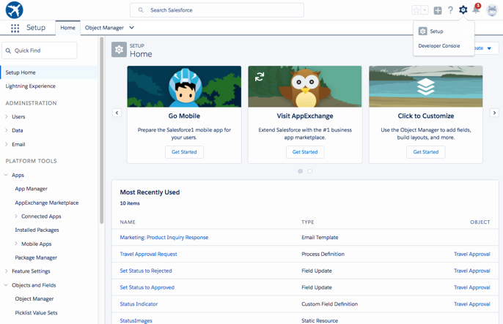
Setup Home
Notes:
MRU – for “real” Developer Workshop, retake screen shot to have the main type of data be Department/Departments (easier for first object since it defaults to a Name for Record Name and Travel Approvals will need to have Auto-Number.)

Slide 21
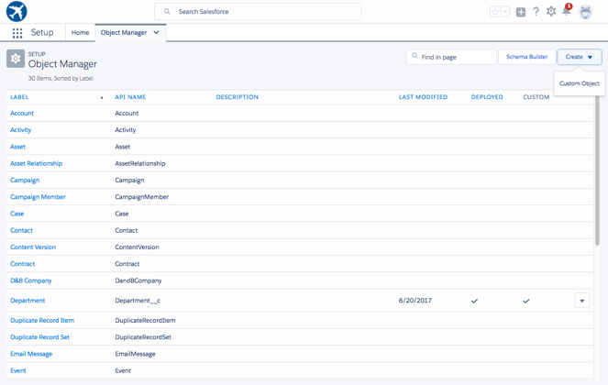
Create New Object
Setup > Object and Fields > Object Manager
Notes:
MRU - replace images using “Custom Object creation.gif” and “Custom Object Definition Edit - Departments.gif”

Slide 22
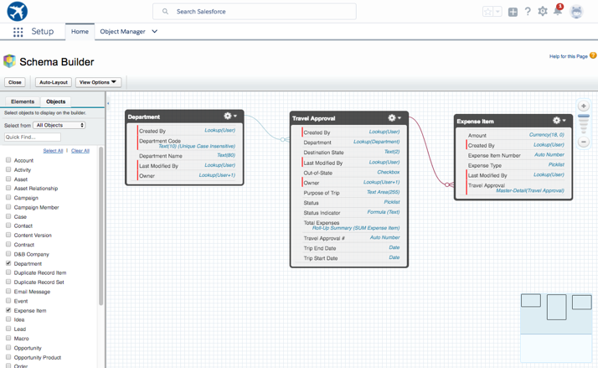
Schema Builder
Notes:
MRU – come back and take screen shot after data model is built

Slide 23
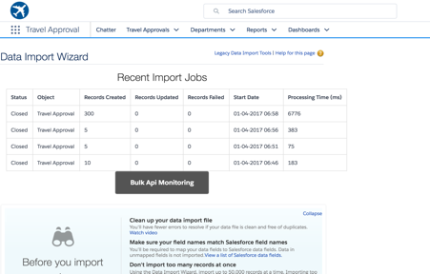
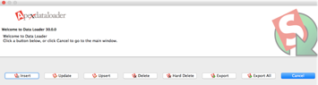
Tools for Data Management
Data Import Wizard
Easy to use data migration tool within Salesforce
Imports accounts, contacts, leads, solutions, and custom objects.
Imports up to 50,000 records.
API-based Tools
Open Source Tools
Data Loader
Partner Tools
Custom-built Tools
Load any object
Load > 50k records
Schedule regular data loads
Export data for backup
Mass delete
Data Import Wizard
Apex Data Loader

Slide 24
Mobile

Slide 25

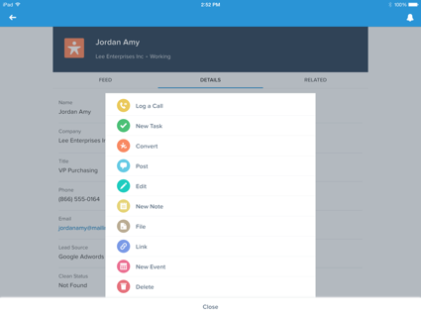

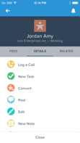
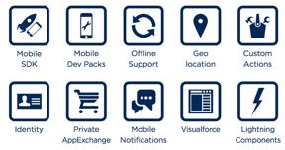



Salesforce1 Mobile
Instantly Mobile Browser-based configurations are instantly mobile
Multiple Platform Support Android, iOS (native); Microsoft (via Browser)
Mobile Services
Notes:
MRU – Show app that was built on the mobile device
Companies have struggled to deliver mobile apps because they are often
forced to make trade-offs between a great experience access to
business data and a development speed. And turning to a silo’d mobile
development environment creates integration challenges and makes
upgrades a daunting task
With the Salesforce one platform there are no trade-offs your company
can leverage the trusted enterprise cloud platform that holds all of
your business data and customer data to deliver the engaging mobile
apps users want with all the data that makes them valuable
This makes it possible to develop mobile first without leaving the
core businesses behind so you're not only able to seamlessly integrate
valuable data that can be updated in real-time with a single view of
the customer employee and partner information in one place, but you
can take advantage of mobile's unique advantages like Geo location
services to help employees get more done anytime anywhere
Mobile services highlights
Salesforce mobile SDK. This open source SDK makes it easier than ever
for developers to securely connect enterprise data to any mobile app
natively hybrid or HTML5 on any iOS or android device the STK also
enables HTML5-based apps to easily leverage device features like
camera and Geo location services and provide additional libraries for
enterprise requirements such as authentication and secure off-line
storage
Developer mobile packs. These open source Quickstart packs and able
any web developer to build highly responsive HTML5 or hybrid mobile
apps on any platform and access real-time salesforce data. Mobile
packs leverage the massively scalable and trusted Salesforce one
platform rest APIs through a choice of popular lightweight JavaScript
frameworks Amber angular JS backbone.JS and J query mobile to offer a
greater development flexibility and delivered amazing data centric
mobile experiences
A closer look at the Salesforce one mobile app.
The Salesforce one mobile app is the ultimate business app designed to
help you run your business from your phone. It is built to let you
take Salesforce anywhere, letting your teams collaborate and take
action in the moment, everywhere. Any app you build on force.com can
be instantly mobile with a tap. And you can extend and customize the
power of Salesforce with the easy development of Salesforce one ready
mobile apps from the app exchange and the salesforce one platforms
easy to use customization tools. It's a perfect example of how point
and click development and mobile services work together.

Slide 26
Branding / Custom UI

Slide 27
Two Approaches to Development
Declarative Approach
Programmatic Approach
Lightning Apps/Pages
Page Layouts
Record Types
Lightning Components
VisualForce Pages
User Interface
Formula Fields
Validation Rules
Workflows and Approvals
Apex Controllers
Apex Triggers
Business Logic
Custom Objects
Custom Fields
Relationships
Metadata API
REST API
Bulk API
Data Model
Notes:
Our Basics workshop covers the declarative side of our platform, but let’s do a quick review.

Slide 28
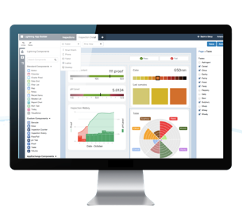
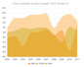
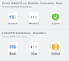
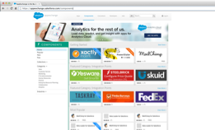
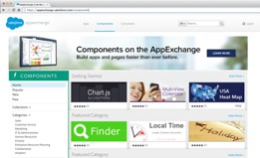
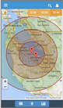
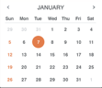
Lightning: A New Way to Deliver Engaging Enterprise Apps
Democratizing Component-Based App Building
Lightning Components
Lightning App Builder
AppExchange for Components
Notes:
And that is why we are so excited today to be delivering Salesforce1 Lightning: a revolutionary way for IT leaders to build and deploy engaging apps to the entire enterprise, fast,
Lightning: made up of the new components, and app builder, now enabed anyone in the company to create trusted app for any business process faster than ever before by leveraging the new component based technology.
Now IT can focus on building set of lightning components, once, and then those components can be shared out with anyone in the company.
Then, With the Lightning App Builder anyone in the company can access these components, and use them to assemble their own apps.
And they can even expand their reach with the new AppExchange for Components, an entirely new part of the Salesforce AppExchange, where anyone can access components built by Salesforce developers and partners, and integrate them into their app through the Lightning app builder.
So those are the new products, and I would like to take you through them in a bit more detail, and then show you a demo.

Slide 29

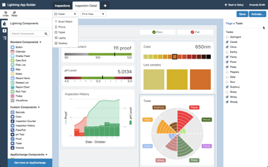
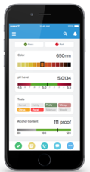



Empower Everyone with the Lightning App Builder
Now Anyone Can Build Apps for Every Device
Drag & Drop Build with standard and custom Lightning Components
Any Device Design apps for every screen from one canvas
Notes:
But whats really special about Lighting is not just components, it is that IT can share these components with anyone in the company, in our new Lightning App Builder, where anyone in your company can easily compose consumer-grade user experiences for any app, simply by dragging and dropping the components into place. And of course, because its purpose built for the enterprise, components inheret our user profiles and sharing rules, so IT can govern who can access what data and functionality. This means the woman who know the business and understand the process, are the ones building the apps, vastly reducing the need for iterations.

Slide 30
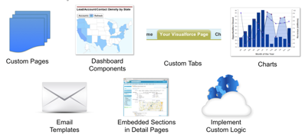
Visualforce
Framework to build custom user interfaces
Hosted natively on Force.com
Build streamlined UX
Extend Salesforce.com
Customize for different devices
Leverage other web technologies
What can you do with Visualforce?
Application Developers
Visualforce
Notes:
The Salesforce1 Platform is the only cloud app platform that enables BOTH business analysts, or ‘citizen developers’, AND professional developers to create apps quickly
For Professional Developers
Developers gain even deeper access to customize and integrate with existing business systems.
Developers have access to rich API’s to integrate and can use a cloud IDE or Eclipse for their programming environment.
Languages like Force.com Apex, customizable UI via Visual Force, or languages such as Java, Ruby, Node.js, or PHP can be used.
Developers love choice and flexibility, and the Salesforce1 Platform offers a wide array of development languages. It’s easy to build employee apps that are tightly integrated on Force.com and take advantage of the rapid scale of Heroku to build beautiful customer apps. Together, they extend the power of Salesforce across your entire business.
Heroku – which we won’t talk about because it’s not GovCloud!
For developers that want to build in a flexible, coder-friendly environment in the language of their choice, Heroku provides everything they need to iterate quickly and create amazing customer apps. They can make changes and deploy them instantly, grow with ease, and get full control, infinite capacity, and independent scaling for each component of the app.
Heroku is designed from the ground up for developer productivity, making it truly possible to create amazing apps that delight your customers, employees, and partners.
Heroku Language Support Includes:
• Java • Node.js • Clojure • All JVM languages
• Ruby on Rails • Python • Scala
.

Slide 31
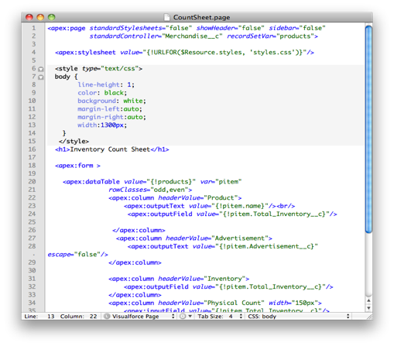
Visualforce Markup
Visualforce tags
80+ standard components
Custom components
Include standard web technology
CSS
Javascript (jquery, extJs etc)
HTML
Flash
Or any other web-enabled code

Slide 32

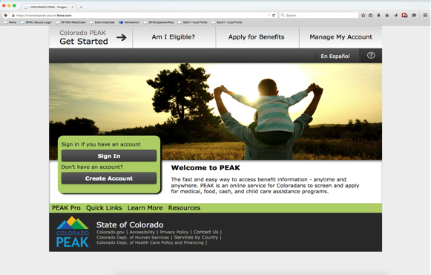

Example UI
State of Colorado PEAK

Slide 33
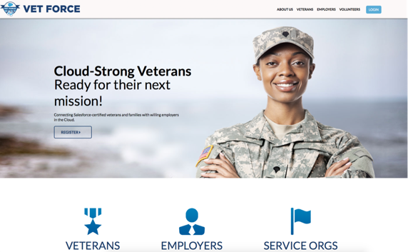
Example UI
https://veterans.force.com/

Slide 34

Customize a User Interface
Notes:
Hi Everyone, my name is ___________ and I’m a ___________ at Salesforce. Today, I’d like to take you on a journey to show you how to connect with your customers in a whole new way. And we’re going to show you how to do that with the Salesforce Customer Success Platform.

Slide 35
Overview: Customize a User Interface
Create Views of Data
Modify a Page Layout
Enable Social Collaboration
PAGES: 30-47 TIME: Done by 1pm
Notes:
MRU - remove 9 & 10 for IEDW

Slide 36
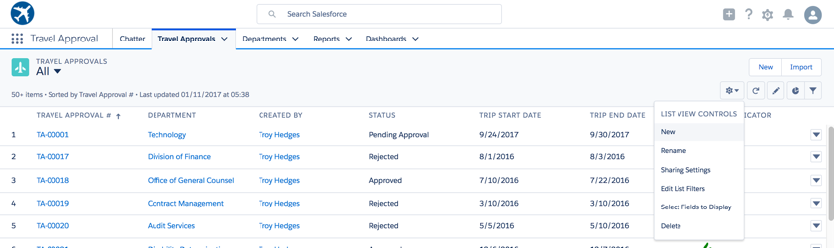
Create Views
Create list views for frequently performed searches / queries
Save list views for future use
Filter on specific field or combinations of fields
Specify which groups of users have access to the view
Follow records and view related Chatter posts

Slide 37
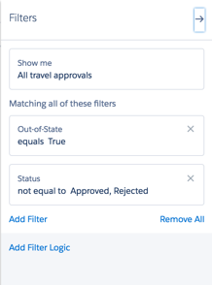
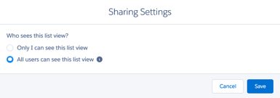
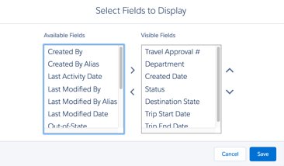
Create Views (continued)
Specify filters
Creating a list view
Specify Visibility
Select up to 15 Columns

Slide 38
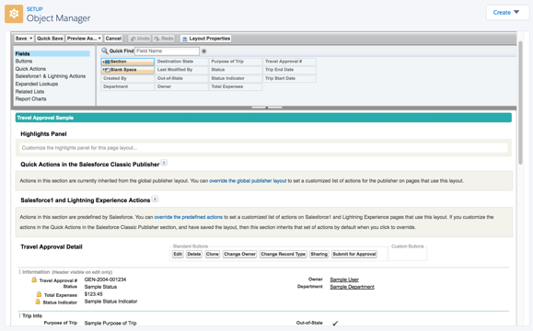
What is a Page Layout?
A page layout controls the fields, sections, related lists and buttons that appear when users view or edit a record of data. You can modify an object’s default page layout or create new ones and associate them to different profiles.
Select Fields, Actions, Buttons, Related Lists
Select Fields, Actions, Buttons, Related Lists;
Drag/Drop to Layout

Slide 39
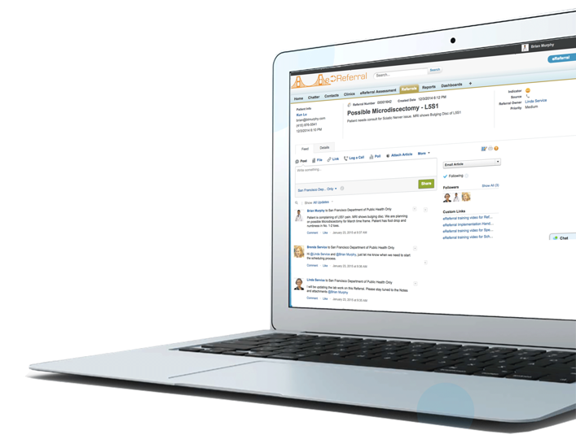

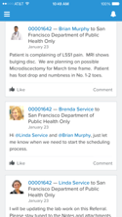

Social Collaboration via Chatter
Feed Tracking Keep up with your critical projects, topics, and teams. Work together on case knowledge in a single location.
File Access Secure, Social and Mobile file sharing puts files in the context of business processes.
Action Bar Create instant actions for any business process; create records, post to feed, add files, request approvals
Social Collaboration
Notes:
With social collaboration at the heart of the Salesforce1 Platform, not only are your users social, but so is every record, every case, every opportunity, every page, and every app. In fact, with just a few clicks, the Salesforce1 Platform lets you build all of this spectacular social collaboration power into any app that you create. Instantly.
FEEDS
Keep up with your critical projects, topics, and teams. Work together on sales knowledge in a single location.
FILES
Secure, Social and Mobile file sharing puts files in the context of business processes. You can alsways find what you need to fast and discover valuable resources yod didn’t even know abut
FOLLOW
Follow actual business records in context. Anytime you follow a record, the feed is pushed to your home page so you can stay abreast of key information as it happens!
ACTION BAR
Create instant actions for any business process; expense reports, support cases, orders and more. Customize actions , enable approvals, add polls and share dashboards and reports. Even ntegrate to 3rd party apps
SOCIAL INTELLIGENCE
Get recommendations for relevant people, files and information to follow based on your activity and interests. Search and Track any topic to quickly find information and identify experts

Slide 40

What is Chatter?
Chatter lets you collaborate with fellow employees, partners and customers on files, records and groups. Chatter is automatically enabled in all orgs.
Follow
People, records, files, groups
Like
Posts
Download
Files
Link
To internal and external links
Comment
On posts, records, topics, tags
Social Collaboration
Attach
Files to posts and records
Organize
Posts and records

Slide 41

Adding Application Logic with Clicks, not Code
Notes:
Hi Everyone, my name is ___________ and I’m a ___________ at Salesforce. Today, I’d like to take you on a journey to show you how to connect with your customers in a whole new way. And we’re going to show you how to do that with the Salesforce Customer Success Platform.

Slide 42
Overview: Add App Logic w Clicks, not Code
Add a Validation Rule
Add a Roll-up Summary Field
Add a Formula Field to show status indicator image

Slide 43
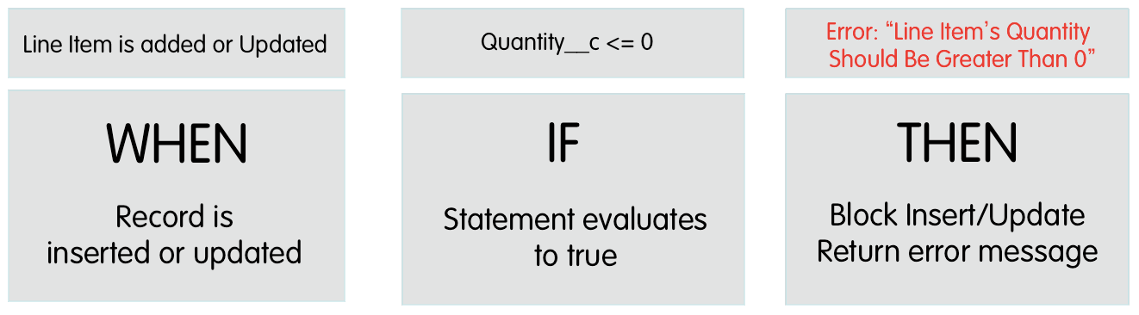
What are Validation Rules?
Validation rules are used to conditionally require field values, format data
Validation rules verify that the data a user enters in a record meets the standards you specify before the record is saved.
A validation rule contains a formula or expression that evaluates the data in one or more fields and returns a value of True or False.
Validation rules also include an error message to display to the user when the rule returns a value of True due to an invalid value.
Error message can be displayed directly below field or at top of the page.
Multiple error messages may be displayed at one time

Slide 44
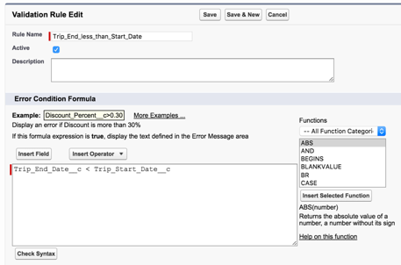
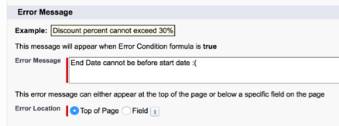
Validation Rule
Specify your “Error” Message
Syntax for Rule

Slide 45
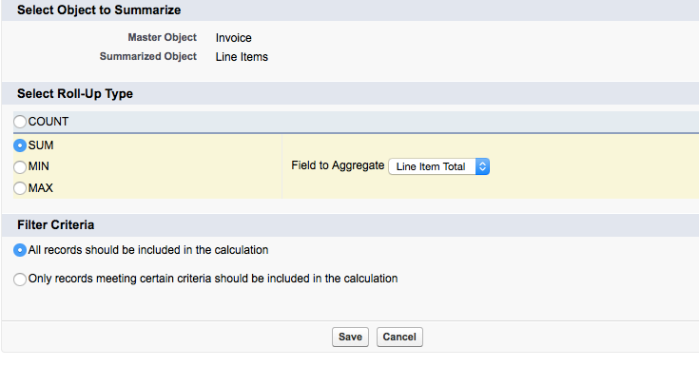
What are Roll-up Summaries?
Roll-up Summary fields are read only formula fields that can display the sum, min, or max value or record count of a field in a related list
For all custom master-detail relationships
There is an option to include ALL records in the roll-up or just records that meet certain filter criteria that you define
Select Summarized Object
Select NUMERIC field to summarize

Slide 46
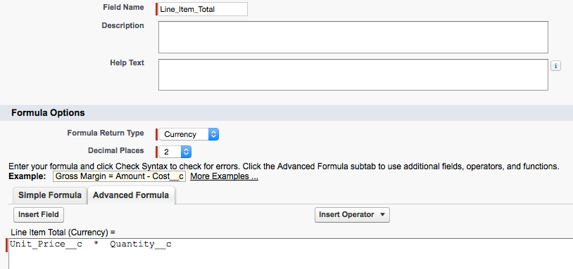
What are Formula Fields?
“Smart” custom fields that can be used to build business-specific calculations using simple wizards and an Excel-like formula language
Can reference standard, custom, or other formula fields
Can reference fields on related (cross) objects
Can return a dynamic image based on logic

Slide 47
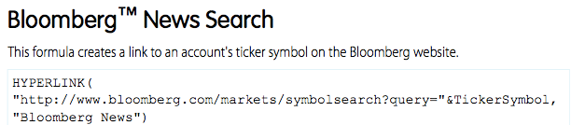
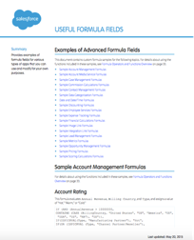
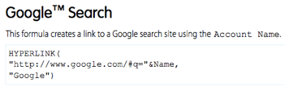
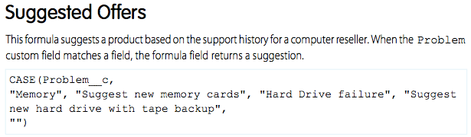
Useful Formula Fields Reference Guide
https://help.salesforce.com/help/pdfs/en/salesforce_useful_formula_fields.pdf

Slide 48
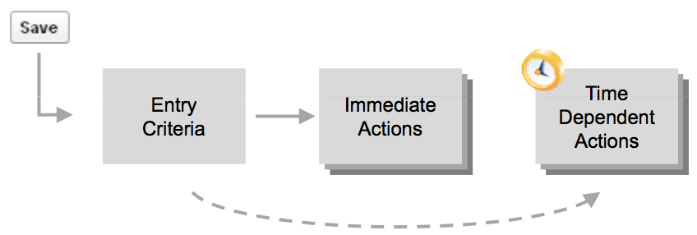
Workflow Rules
Automate Business Processes
Triggered on record creation or update
Execute actions
Immediately and/or
Later - only of record still meets the entry criteria (Time-based Workflow)
Actions: Update Record, Send Email, Create Task, Send Outbound (SOAP) Message

Slide 49
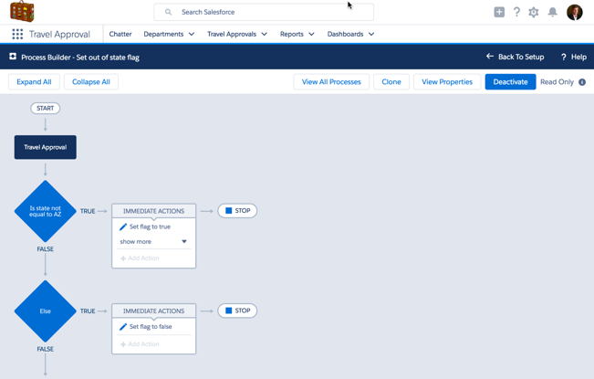
Overview: Add App Logic w Clicks, not Code
Automate a Field Update using Workflow Process Builder

Slide 50
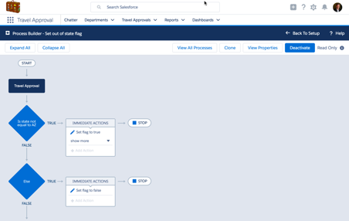
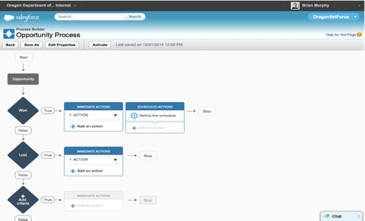

Workflow Process Builder
Visualize Visualize the entire process in one place to design and collaborate directly with lines of business owners
Easy to Use Easily automate complex business processes with point-and-click tools
Event-driven Actions Automatically update or create new records, emails, and tasks or send data to an external system
Workflows

Slide 51

What is an Approval Process?
Approval processes are single or multi-step business processes that require end user authorization for record promotion
X

Slide 52

Overview: Add App Logic w Clicks, not Code
Create an Approval Process for travel requests

Slide 53

Analyze Data with Reports and Dashboards
Notes:
Hi Everyone, my name is ___________ and I’m a ___________ at Salesforce. Today, I’d like to take you on a journey to show you how to connect with your customers in a whole new way. And we’re going to show you how to do that with the Salesforce Customer Success Platform.

Slide 54
Overview: Analyze Data with Reports and Dashboards
Create a Report
Create a Dashboard

Slide 55

Embedded Analytics
Make smarter business decisions to drive service transformation
Personalized Create personalized reports and dashboards on your transactional business data via drag & drop
Secure Reporting data maintains access control, based on roles and profiles
Analytics
Notes:
One of the biggest problems IT has faced over the last few years has been satisfying the demand for business analytics. With more and more customer information being shared and used by different teams for sales, service, marketing, product, R&D, supply chain, and more, business stakeholders are naturally asking for more ways to look at, and work with, that data. And since the pace of business today is moving faster than ever, that means seeing it not next month, or next week. Not even tomorrow. But in real time. Until now, that’s been nearly impossible to deliver without purchasing expensive business intelligence software that is hard to implement (and often hard to use), or dedicating a specific group of IT staff to developing a customer solution to help business stakeholders crunch numbers.
The Salesforce1 Platform takes the need for all of that out of the picture, delivering a flexible UI that allows business stakeholders to create personalized reports and dashboards by department, role, and individual with the simplicity of drag-and-drop tools. You can literally just drag-and- drop the fields, filters, groupings, and charts that you want, and get an immediate real time view, with instant drill-down to operational data. Then you can sharg insights via social feeds and across mobile devices. And since the data is all stored on the Salesforce1 Platform’s cloud database using a multitenant infrastructure, it’s accessible with the security you can trust, on any device, anywhere in the world, on demand.

Slide 56


Salesforce Reports
Salesforce Reports are lists, summaries or matrices that allow you to aggregate and analyze your data in different ways
Table Report

Slide 57

What is a Dashboard?
A dashboard is a visual representation of data from multiple reports, and:
Comprises up to 20 components
Displays data from custom source reports
Can use Visualforce Pages to present data from other sources
Has a “running user” to determine what data is visible
Displays data as of the last time the dashboard was refreshed
Can be scheduled to refresh and and be automatically emailed

Slide 58
Closing Thoughts

Slide 59




4 million…and growing
Notes:
MRU - Update numbers

Slide 60




success.Salesforce.com
4 million active community members
community
Customer Community
Partner Community
User Groups
Ask Questions
Post Ideas
Notes:
MRU - Update numbers

Slide 61









Become a Salesforce Superhero
Professional Certifications
from Salesforce University

